Slide 1


Getting Started With
Microsoft Access
Database
13
Manager of Information Center
Tendering Department
Arab Contractors
Said Fawzy

Slide 2
Getting Started With
Microsoft Access
Database
13
Advanced Form Design
Manager of Information Center
Tendering Department
Arab Contractors
Said Fawzy

Slide 3

1
Form Design Canvas
2
3 questions Before you start
3
Creating Form Using Blank Form

Slide 4
4
Form Sections
5
Form Controls
6
Property Sheet

Slide 5
7
Sub Forms
8
Tabbed Forms
9
Split Forms

Slide 6
10
Default Value
11
Tab Orders
12
Button Control

Slide 7
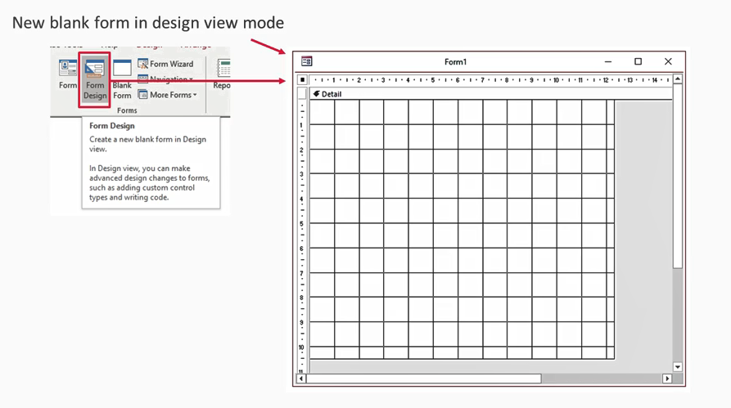
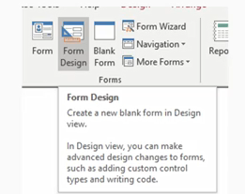
Form Design Canvas

Slide 8
Before you start you must answer 3 questions
What type of form is being designed?
What will be the role of the form?
Will it be attached to a table or query?

Slide 9
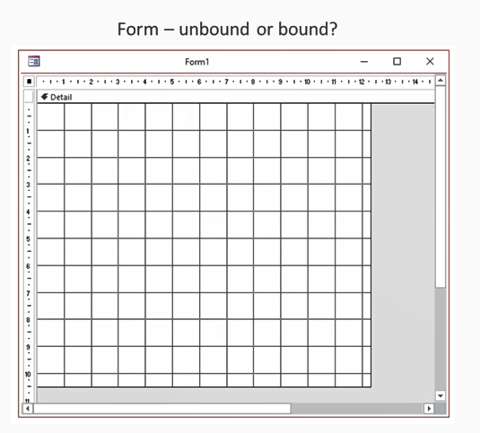
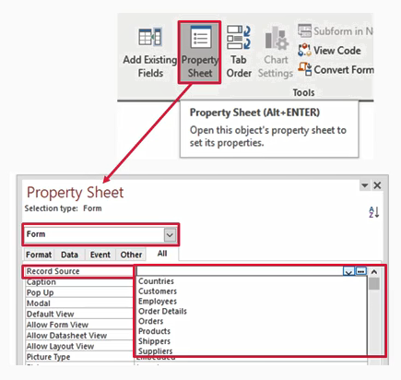
Form Bound or Unbound?

Slide 10
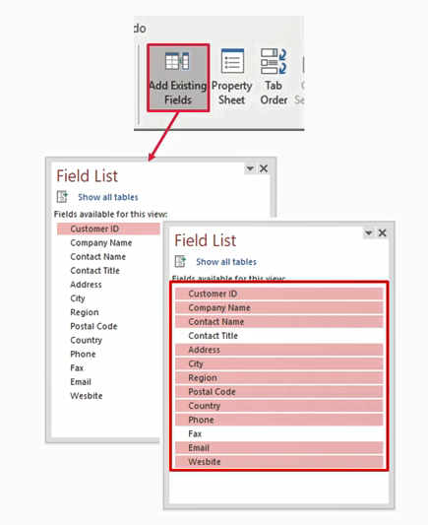
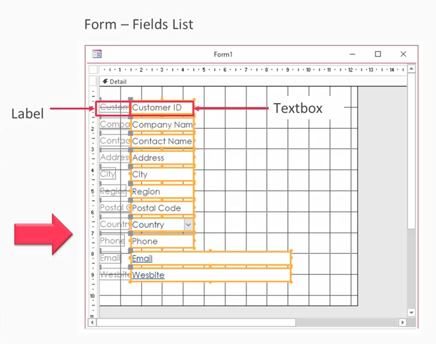
Which Fields you will include?

Slide 11

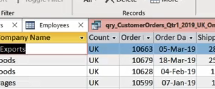
Lab 10A: Creating Form Using Blank Form

Slide 12

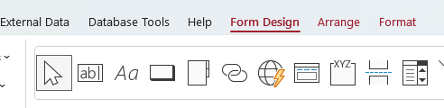
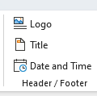
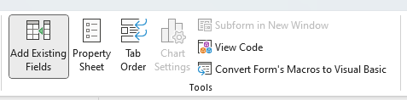
Lab 10A

Slide 13
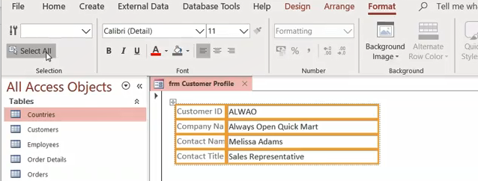
Lab 10A

Slide 14
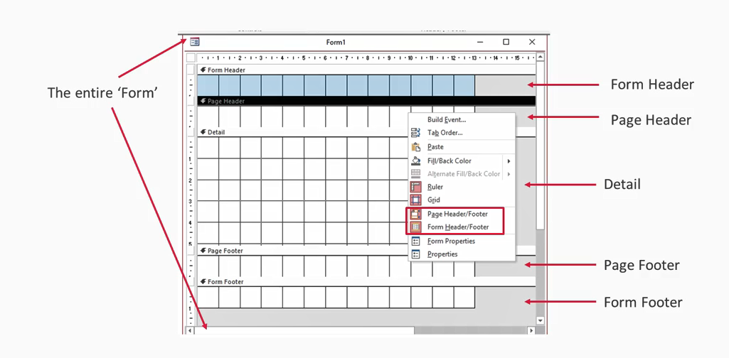
Form Sections

Slide 15
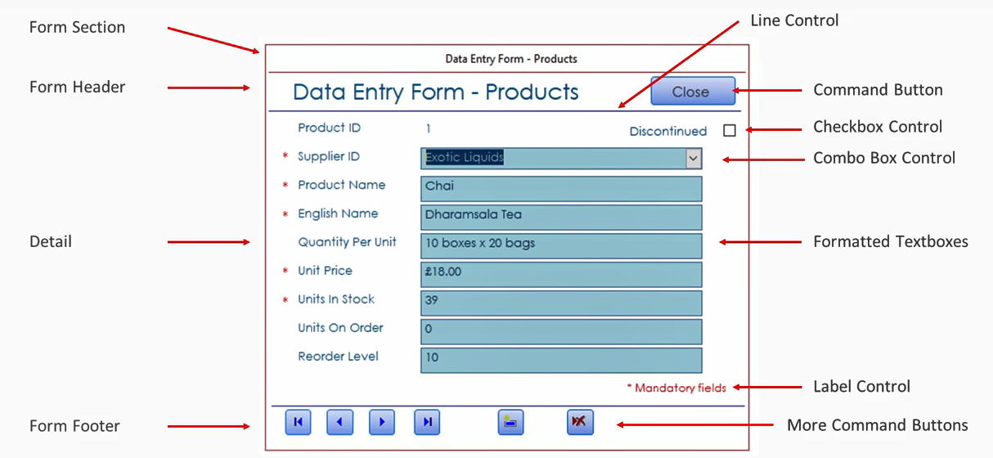
Form Controls

Slide 16
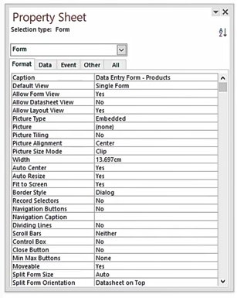
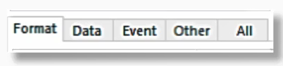
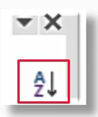
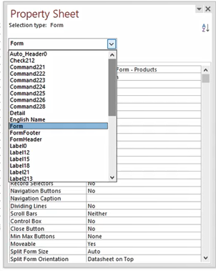
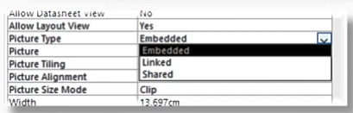
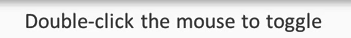
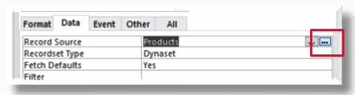
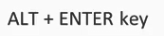
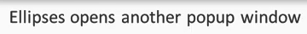
Form Property Sheet

Slide 17
Lab 10B: Continue Exploring Form

Slide 18
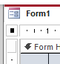
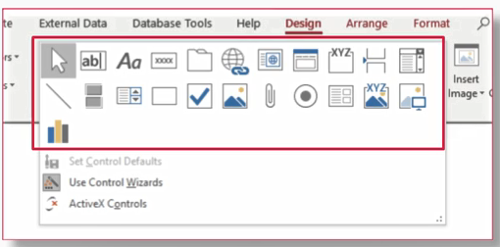
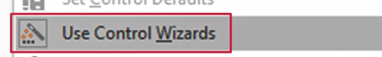
Lab 10B

Slide 19
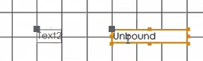
Lab 10B

Slide 20
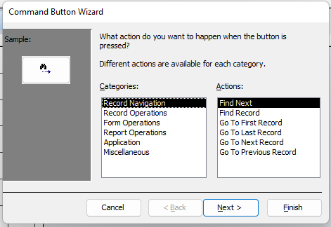
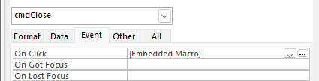
Lab 10B

Slide 21
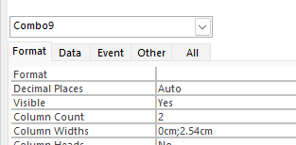
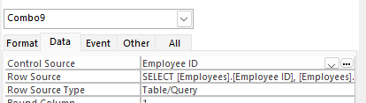
Lab 10B

Slide 22
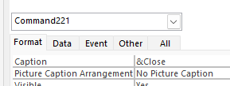
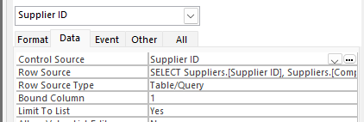
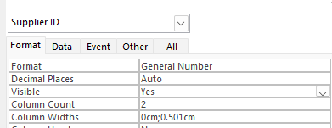
Lab 10B

Slide 23
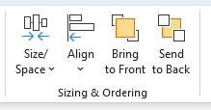
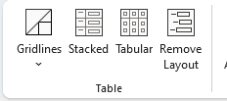
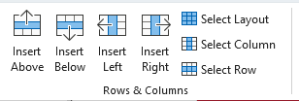
Lab 10B

Slide 24
Form Toolbox Controls

Slide 25
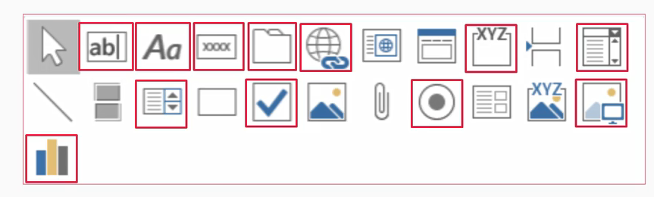
Form Toolbox Controls
Most Common
Text Box, Label ,Command Button , Tab Control , Link , Option Group , Combo Box , List Box ,
Check Box , Option Button , Image ,
Chart Object

Slide 26
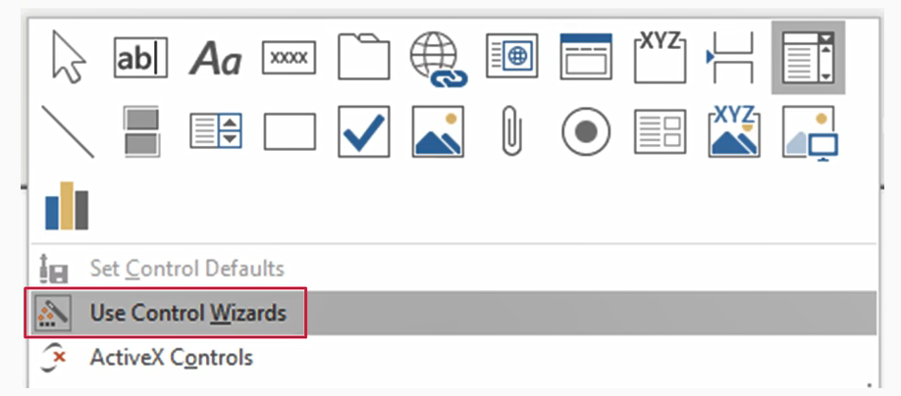
Form Toolbox Controls
Use Control Wizards

Slide 27
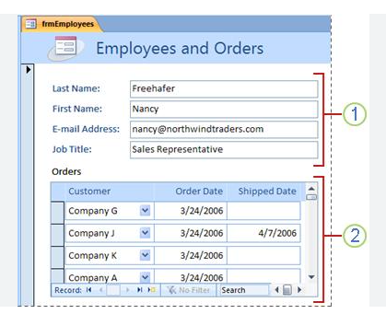
Sub Forms
A Sub form is a form within a form.
When you change the record in the main form, the subform will be updated with related records.
Main Form
Sub Form

Slide 28
Lab 10C: Creating SubForms

Slide 29
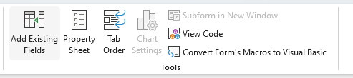
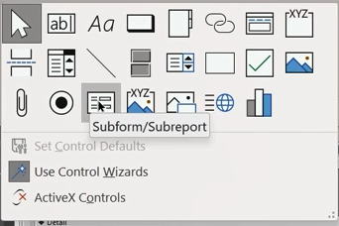
Lab 10C

Slide 30
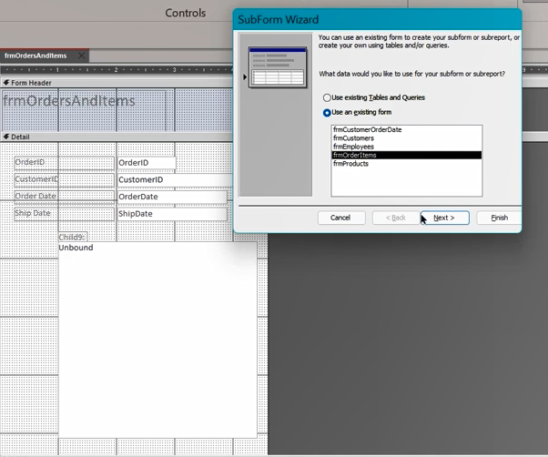
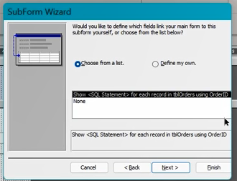
Lab 10C

Slide 31
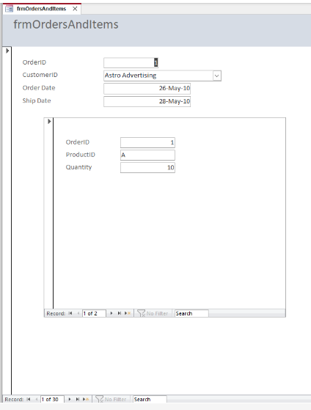
Lab 10C

Slide 32
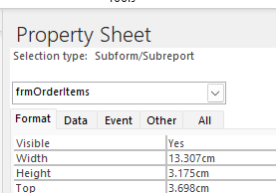
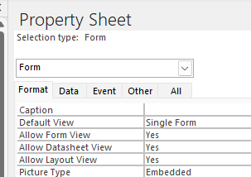
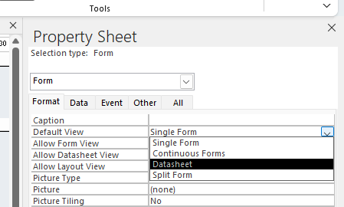
Lab 10C

Slide 33
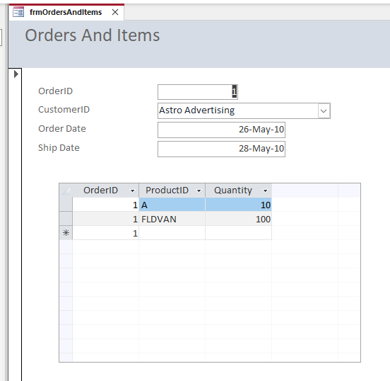
Lab 10C

Slide 34
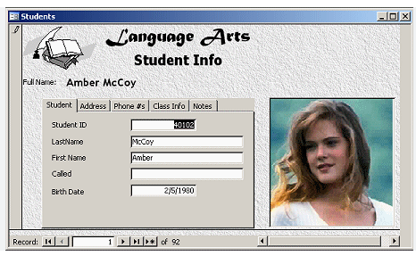
Tabbed Forms
Tabbed form has multiple pages.
If you have a lot of fields of data, you might want to split them into multiple pages.

Slide 35
Lab 10D: Creating Tabbed Form

Slide 36
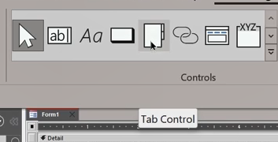

Lab 10D

Slide 37


Lab 10D

Slide 38


Lab 10D

Slide 39


Lab 10D

Slide 40


Lab 10D

Slide 41


Lab 10D

Slide 42

Split Forms
Split form is a form that shows Form on the upper half and spreadsheet in the lower half

Slide 43
Lab 10E: Creating Split Form

Slide 44


Lab 10E

Slide 45
Default Value
Default Value is a Value in a field, by default it is recorded whenever new record inserted if the user did not give it value.
Default value can be changed if the user wants to.
It helps to make date entry faster for repetitive value in the same field.
Example: Order date.

Slide 46
Lab 10F: Using Default Value in a Form

Slide 47



Lab 10F

Slide 48

Form Tab Order

Slide 49
Lab 10G: Arrange the Tab Order in a form

Slide 50

Lab 10G

Slide 51
Lab 10H: Adding a Button Control to a Form

Slide 52


Lab 10H

Slide 53

Build Your Project Part III Create Forms

Slide 54



Said Fawzy

